Slide 1


M.TECH. VDN LAB SESSION
NSDCS Lab,
Indian Institute of Technology Indore
Lab In-Charge: Prof. Santosh Kumar Vishvakarma
Presented by: Shivam Vaish
(2302102034)

Slide 2
SRAM ARCHITECTURE
Nanoscale Devices, VLSI Circuit G System Design Research Group, Department of Electrical Engineering, Indian Institute of Technology Indore

Slide 3
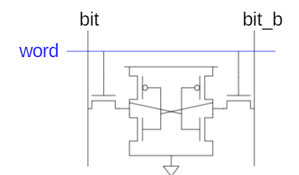
6T SRAM Cell
Cell size accounts for most of array size
Reduce cell size at expense of complexity
6 T SRAM Cell
Used in most commercial chips
Data stored in cross coupled inverters
Read:
Precharge bit, bit_b
Raise Wordline
Write
Drive data onto bit, bit_b
Nanoscale Devices, VLSI Circuit G System Design Research Group, Department of Electrical Engineering, Indian Institute of Technology Indore

Slide 4
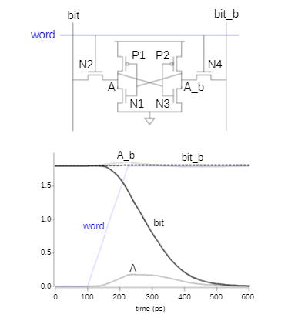
SRAM Read
Precharge both bitlines high
Then turn on wordline
One of the bitlines will be pulled down by the cell
Ex: A=0,A_b=1
bit discharges, bit b stays high
But A bumps up slightly
Read stability
A must not flip
N1>>N2
Nanoscale Devices, VLSI Circuit G System Design Research Group, Department of Electrical Engineering, Indian Institute of Technology Indore

Slide 5
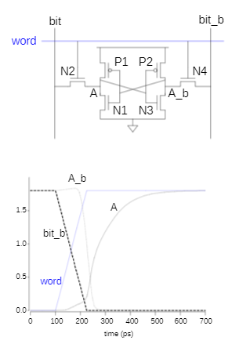
SRAM Write
Drive one bitline high, the other low
Then turn on wordline
Bitline overpower cell with new value
Ex: A=0, A_b=1, bit=1, bit_b=0
force A_b low, then A rises high
Writability
Must overpower feedback inverter
N2>>P1
Nanoscale Devices, VLSI Circuit G System Design Research Group, Department of Electrical Engineering, Indian Institute of Technology Indore

Slide 6
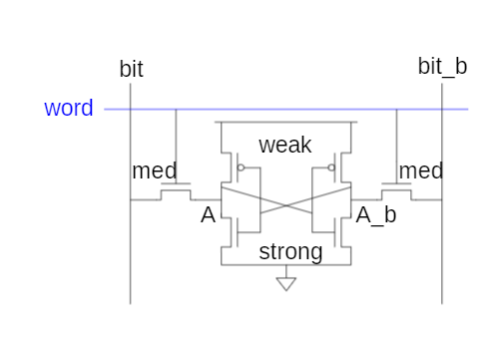
SRAM Sizing
High bitlines must not overpower inverters during reads
But low bitlines must write new value into cell
Nanoscale Devices, VLSI Circuit G System Design Research Group, Department of Electrical Engineering, Indian Institute of Technology Indore

Slide 7
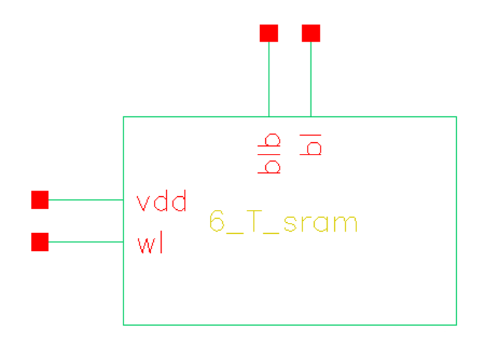
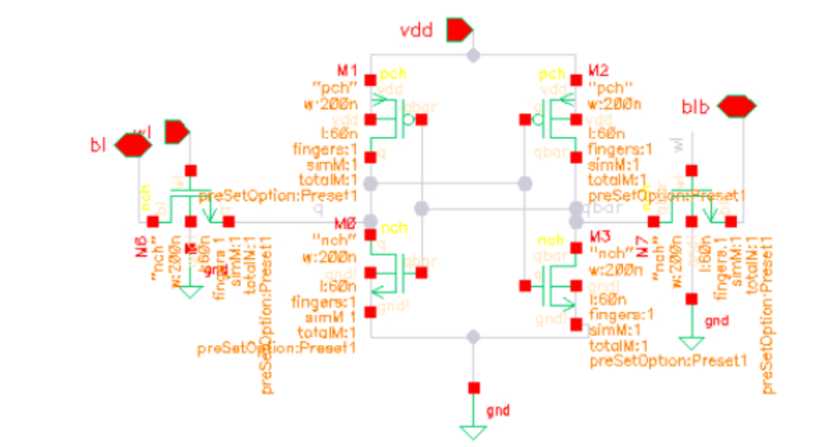
6T SRAM Schematic
Schematic
Symbol
Nanoscale Devices, VLSI Circuit G System Design Research Group, Department of Electrical Engineering, Indian Institute of Technology Indore

Slide 8
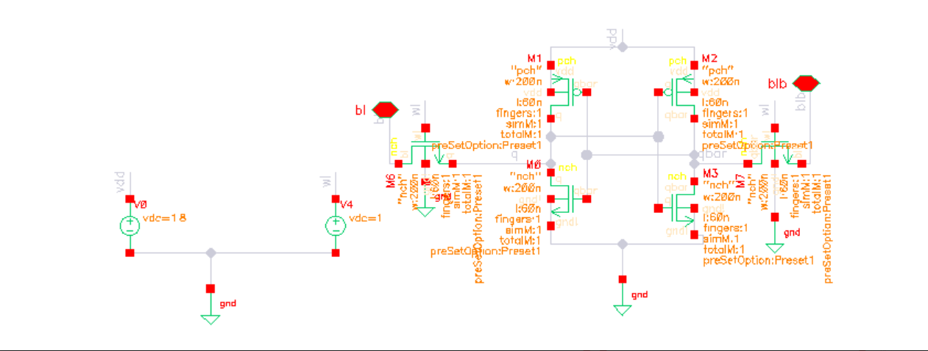
6 T SRAM Test Bench
Nanoscale Devices, VLSI Circuit G System Design Research Group, Department of Electrical Engineering, Indian Institute of Technology Indore

Slide 9
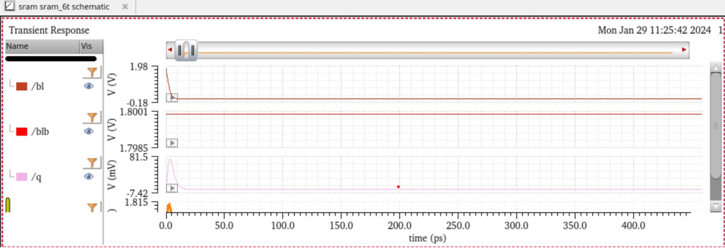
6 T SRAM read 0 waveform
Nanoscale Devices, VLSI Circuit G System Design Research Group, Department of Electrical Engineering, Indian Institute of Technology Indore

Slide 10
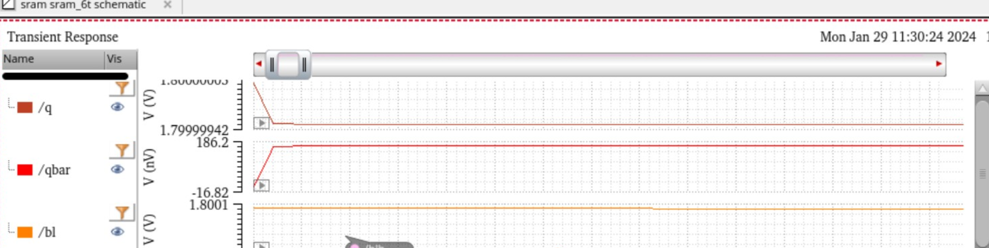
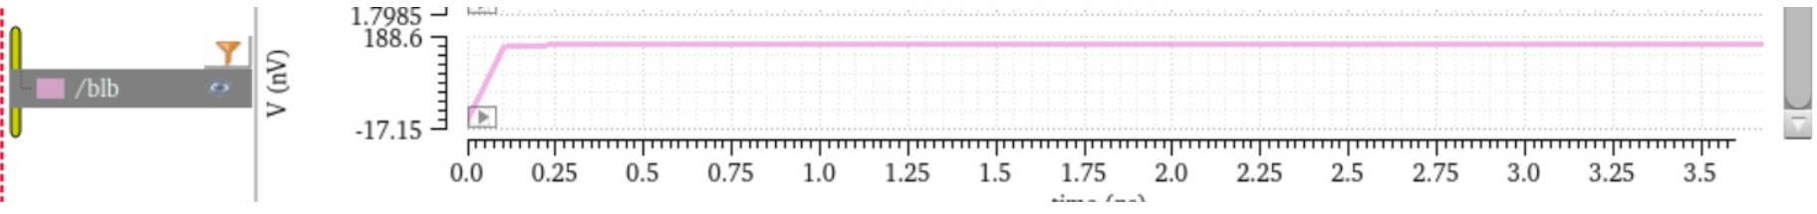
6 T SRAM Write 1 waveform
Nanoscale Devices, VLSI Circuit G System Design Research Group, Department of Electrical Engineering, Indian Institute of Technology Indore

Slide 11
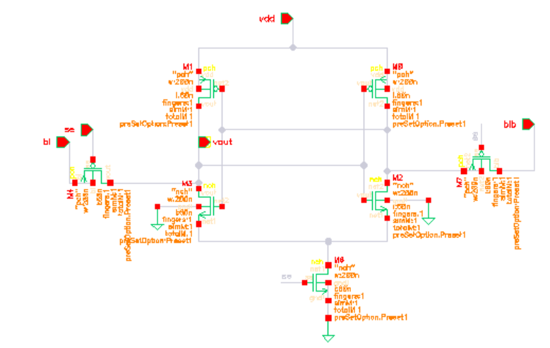
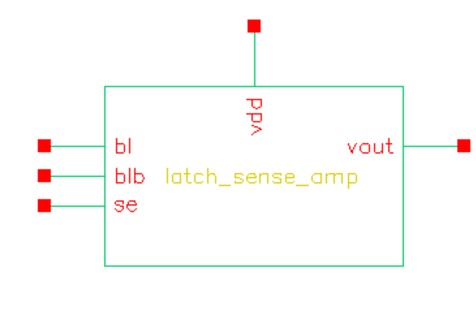
Sense Amplifier using Latch
Schematic
Symbol
Nanoscale Devices, VLSI Circuit G System Design Research Group, Department of Electrical Engineering, Indian Institute of Technology Indore

Slide 12
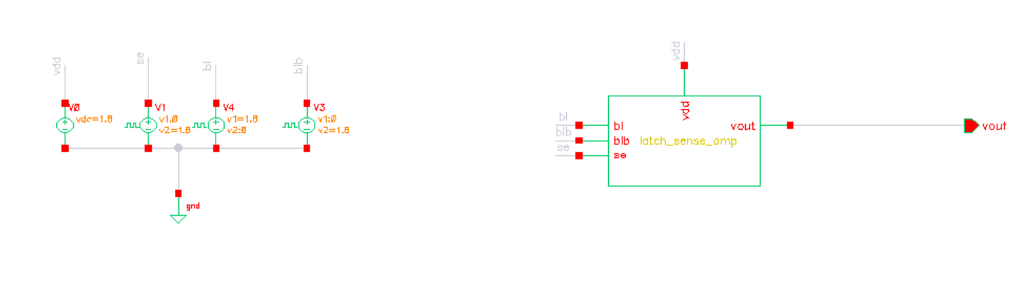
Sense Amplifier using Latch test bench
Nanoscale Devices, VLSI Circuit G System Design Research Group, Department of Electrical Engineering, Indian Institute of Technology Indore

Slide 13
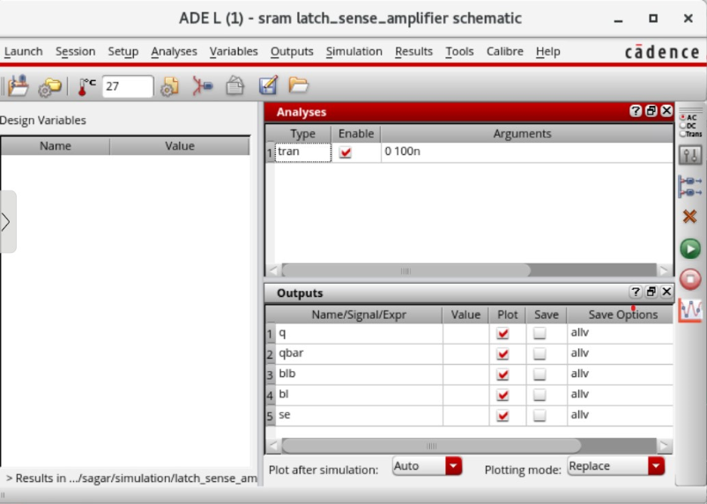
Sense Amplifier using Latch ADE L Window
Nanoscale Devices, VLSI Circuit G System Design Research Group, Department of Electrical Engineering, Indian Institute of Technology Indore

Slide 14
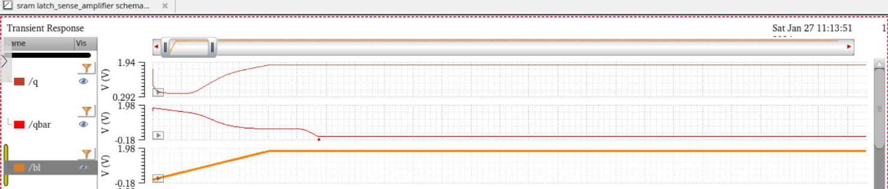
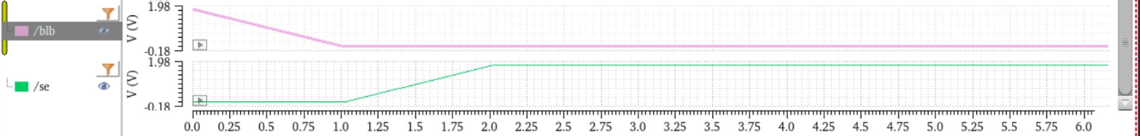
Sense Amplifier using Latch Waveform
Nanoscale Devices, VLSI Circuit G System Design Research Group, Department of Electrical Engineering, Indian Institute of Technology Indore

Slide 15
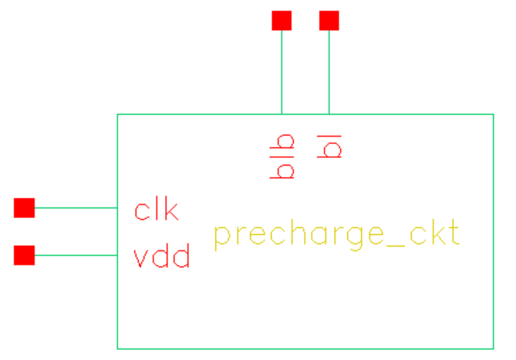
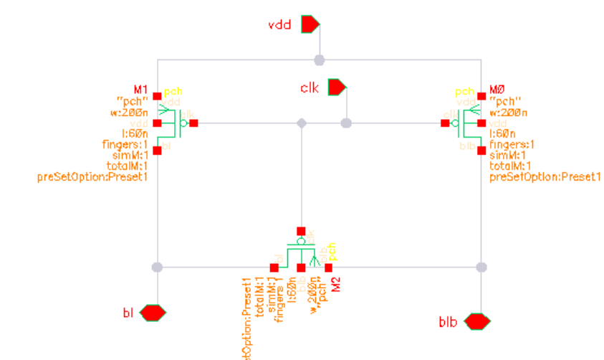
Precharge circuit
Schematic
Symbol
Nanoscale Devices, VLSI Circuit G System Design Research Group, Department of Electrical Engineering, Indian Institute of Technology Indore

Slide 16
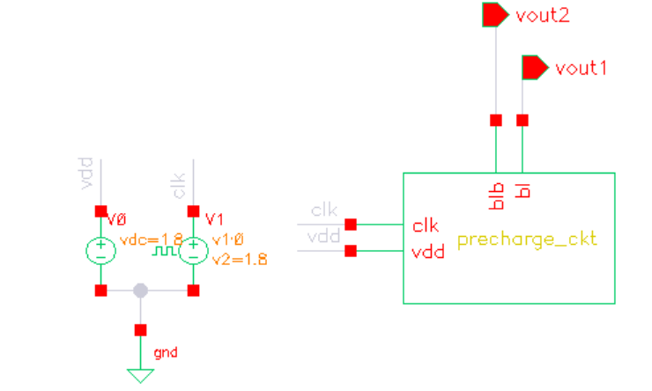
Precharge circuit test bench
Nanoscale Devices, VLSI Circuit G System Design Research Group, Department of Electrical Engineering, Indian Institute of Technology Indore

Slide 17
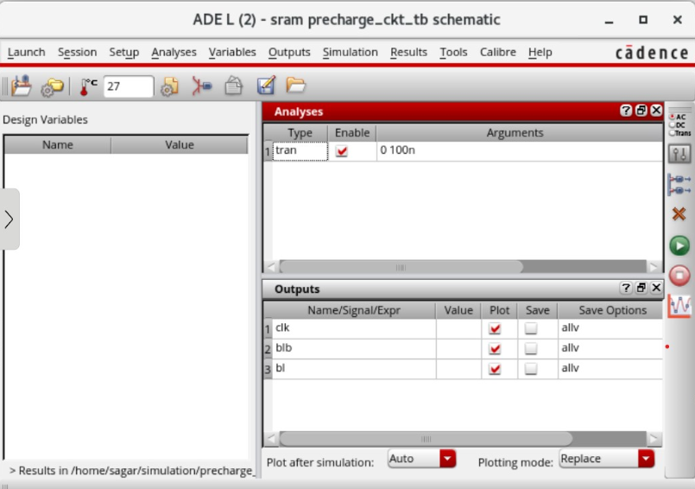
Precharge circuit ADE L Window
Nanoscale Devices, VLSI Circuit G System Design Research Group, Department of Electrical Engineering, Indian Institute of Technology Indore

Slide 18
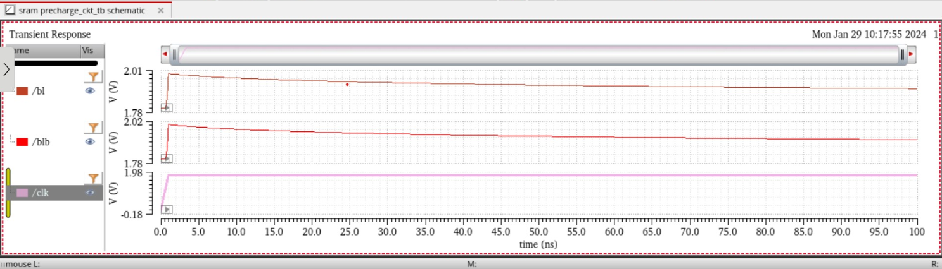
Precharge circuit Waveform
Nanoscale Devices, VLSI Circuit G System Design Research Group, Department of Electrical Engineering, Indian Institute of Technology Indore

Slide 19
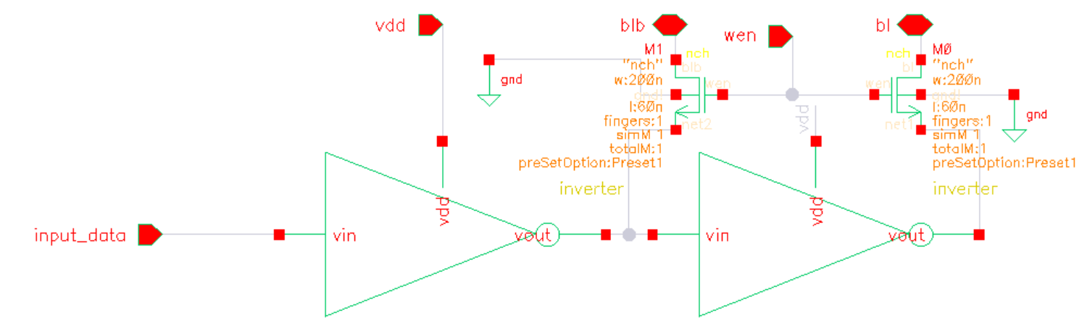
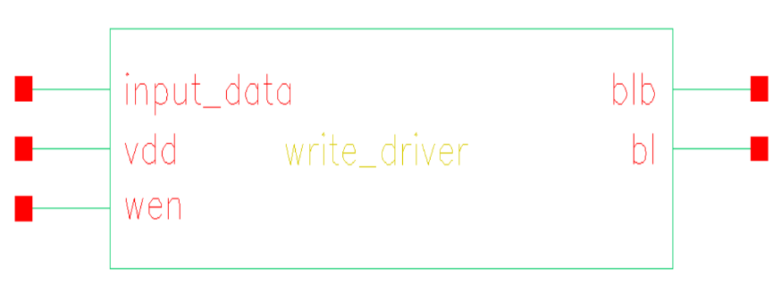
Write driver
Schematic
Symbol
Nanoscale Devices, VLSI Circuit G System Design Research Group, Department of Electrical Engineering, Indian Institute of Technology Indore

Slide 20
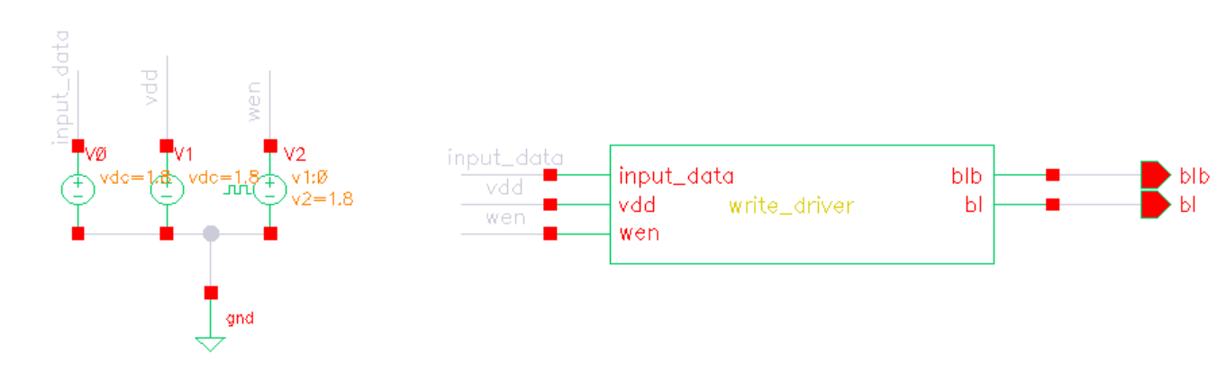
Write driver test bench
Nanoscale Devices, VLSI Circuit G System Design Research Group, Department of Electrical Engineering, Indian Institute of Technology Indore

Slide 21
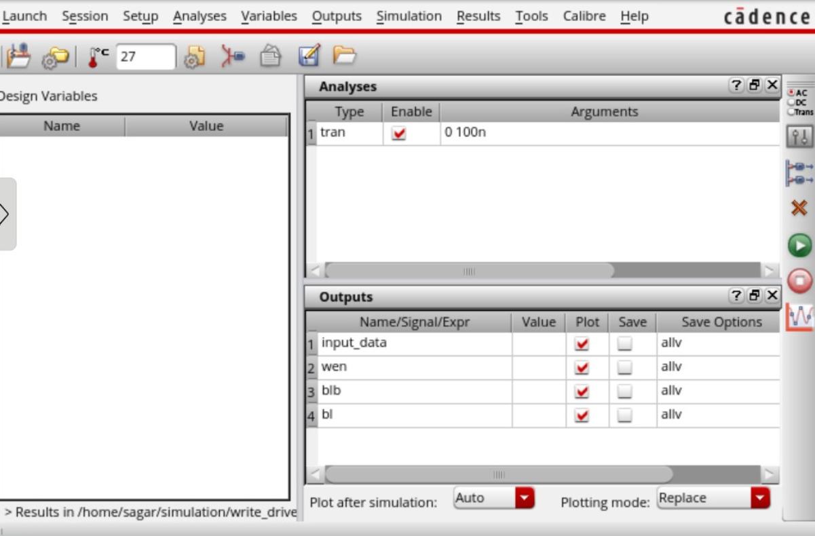
Write driver ADE L Window
Nanoscale Devices, VLSI Circuit G System Design Research Group, Department of Electrical Engineering, Indian Institute of Technology Indore

Slide 22
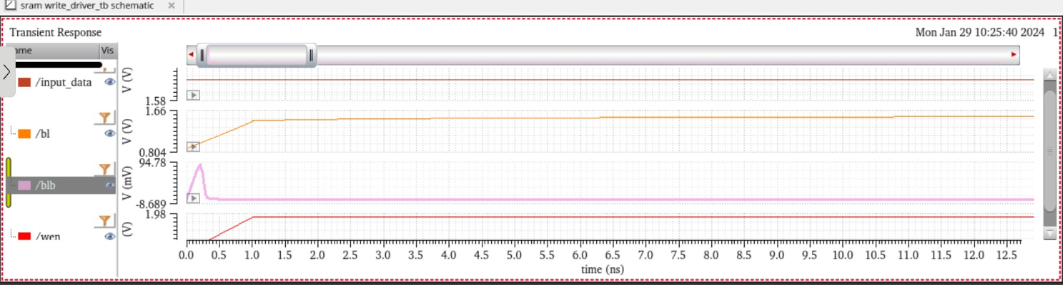
Write driver waveform
Nanoscale Devices, VLSI Circuit G System Design Research Group, Department of Electrical Engineering, Indian Institute of Technology Indore

Slide 23
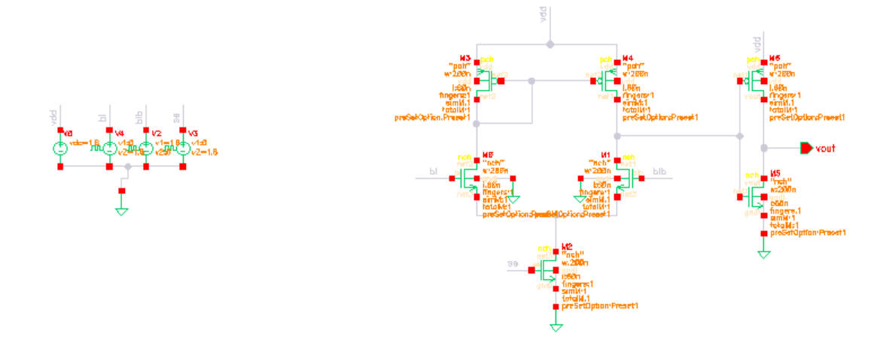
Sense Amplifier using Differential amplifier
Nanoscale Devices, VLSI Circuit G System Design Research Group, Department of Electrical Engineering, Indian Institute of Technology Indore

Slide 24
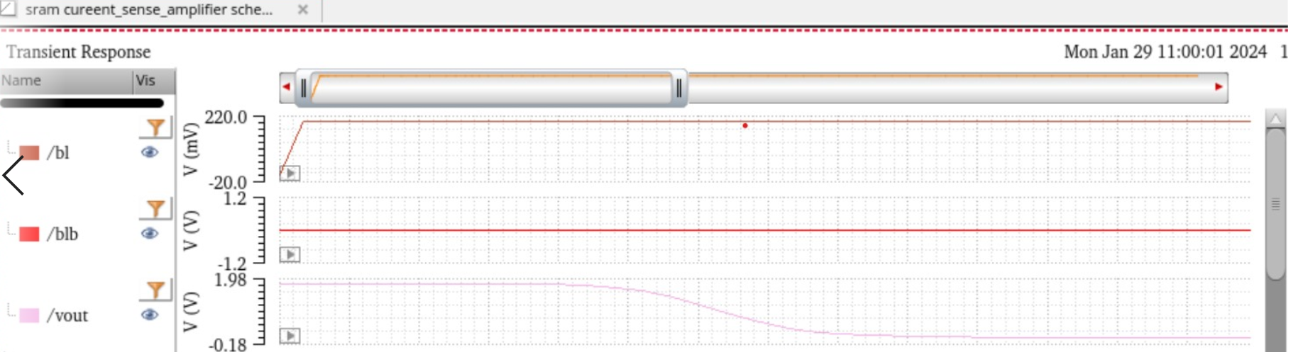
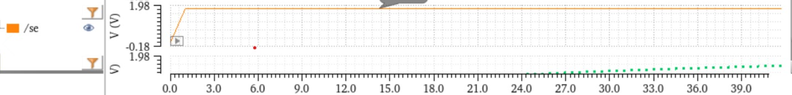
Sense Amplifier using Differential amplifier
Nanoscale Devices, VLSI Circuit G System Design Research Group, Department of Electrical Engineering, Indian Institute of Technology Indore

Slide 25
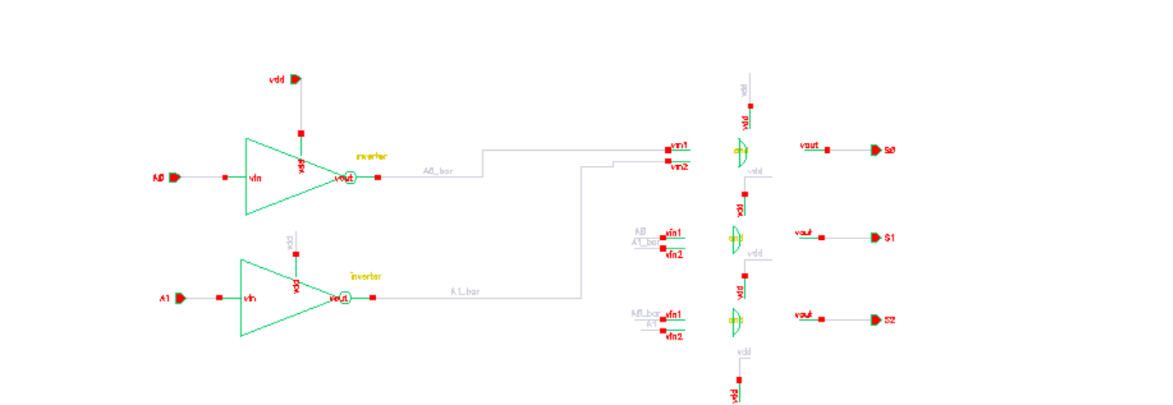
2*4 Decoder Schematic
Nanoscale Devices, VLSI Circuit G System Design Research Group, Department of Electrical Engineering, Indian Institute of Technology Indore

Slide 26
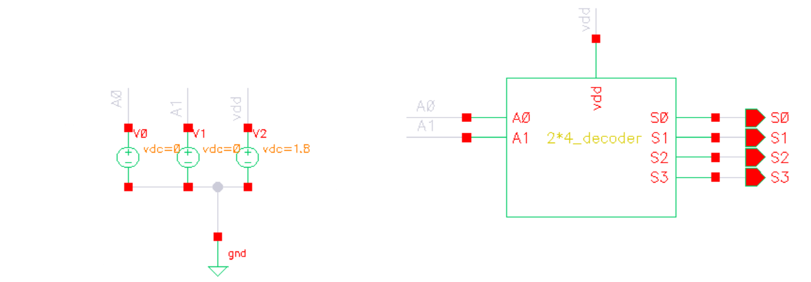
2*4 Decoder Test Bench
Nanoscale Devices, VLSI Circuit G System Design Research Group, Department of Electrical Engineering, Indian Institute of Technology Indore

Slide 27
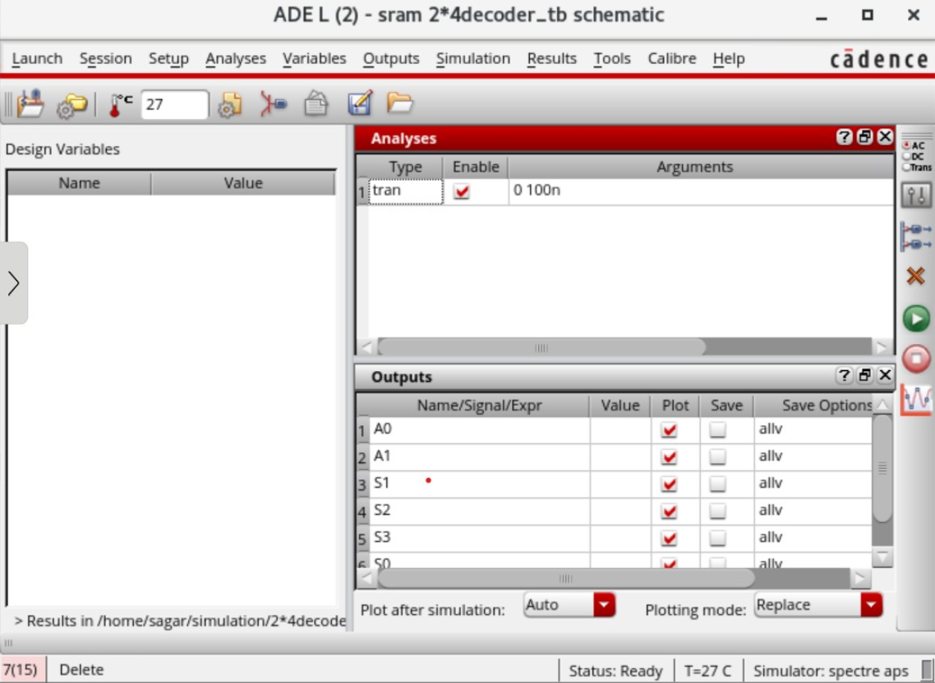
ADE L For 2*4 Decoder
Nanoscale Devices, VLSI Circuit G System Design Research Group, Department of Electrical Engineering, Indian Institute of Technology Indore

Slide 28
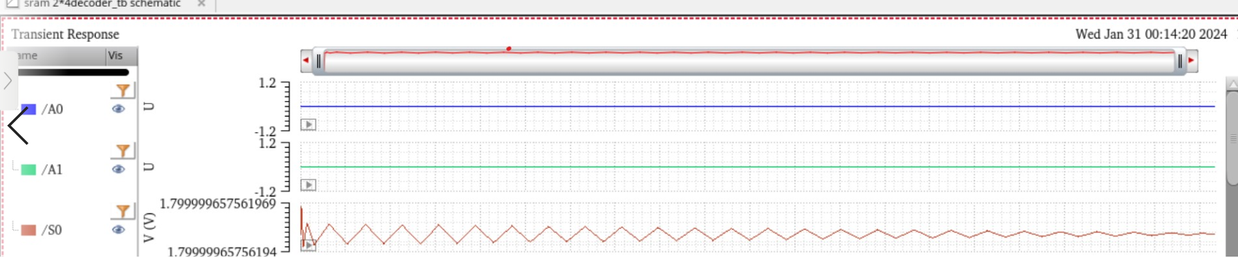
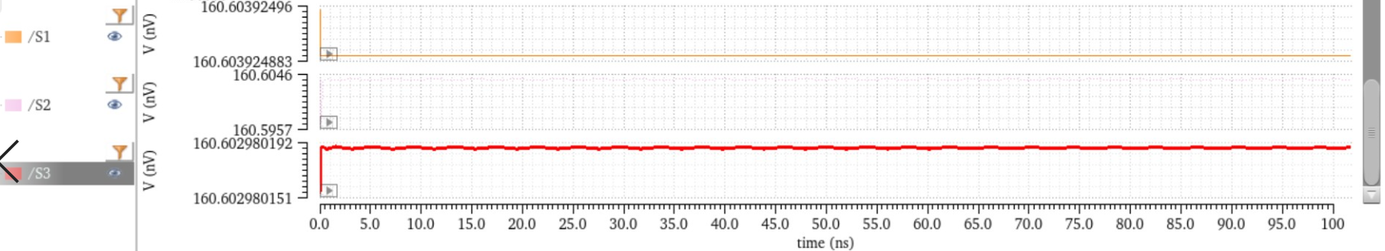
2*4 Decoder
Nanoscale Devices, VLSI Circuit G System Design Research Group, Department of Electrical Engineering, Indian Institute of Technology Indore

Slide 29
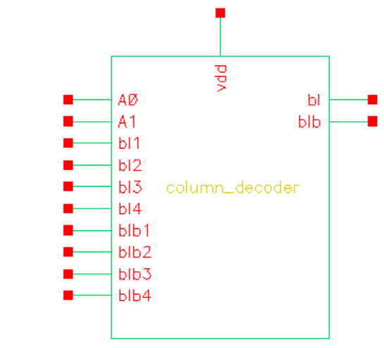
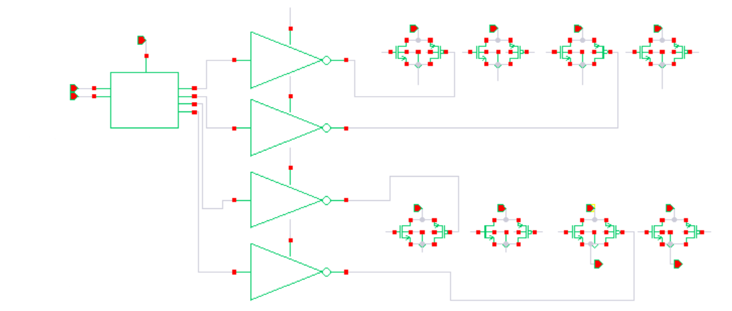
Colum Decoder For 4*4 SRAM Schematic
Schematic
Symbol
Nanoscale Devices, VLSI Circuit G System Design Research Group, Department of Electrical Engineering, Indian Institute of Technology Indore

Slide 30
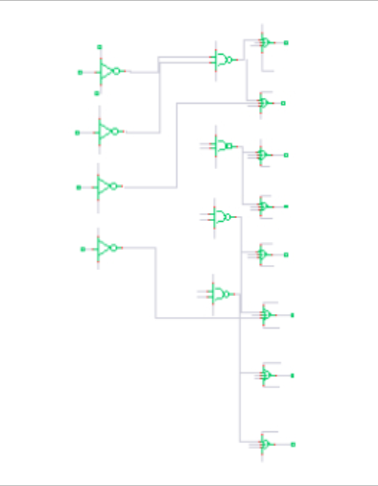
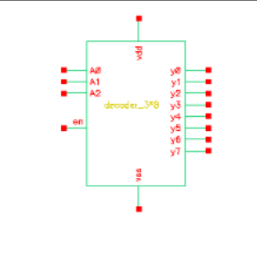
3*8 decoder(using nor and nand gate) using tsmc65nm
Schematic
Symbol

Slide 31
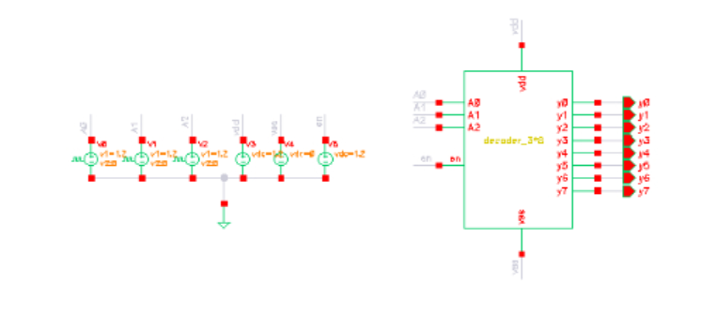
3*8 decoder(using nor and nand gate) using tsmc65nm test bench

Slide 32
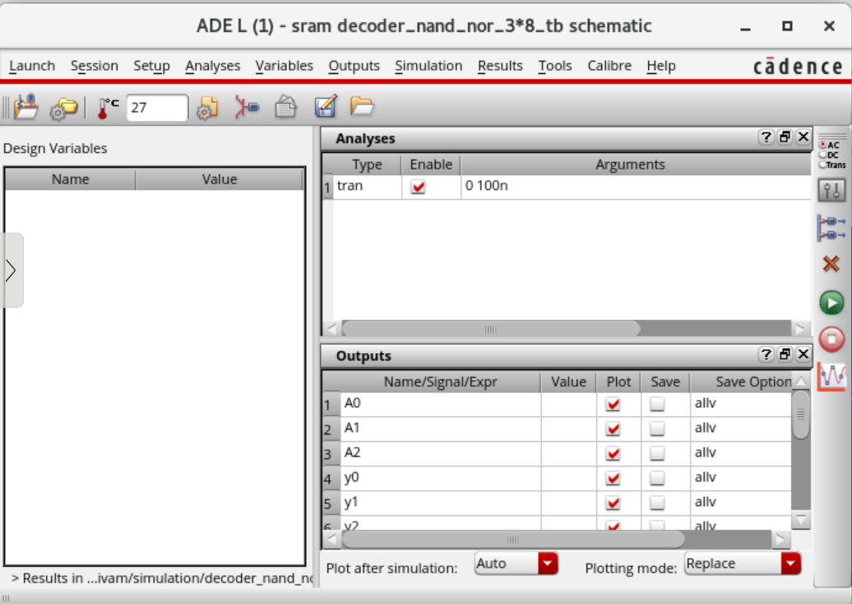
ADE L WINDOW

Slide 33
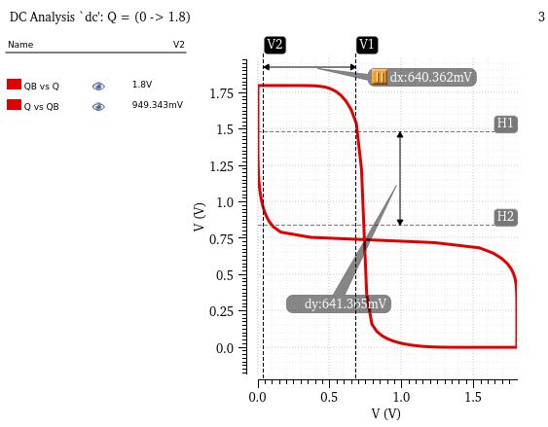
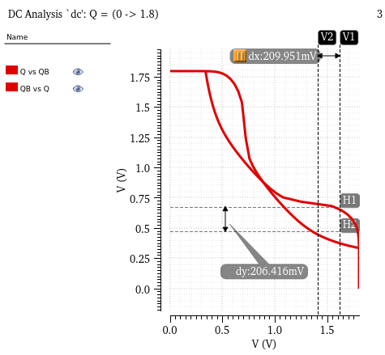
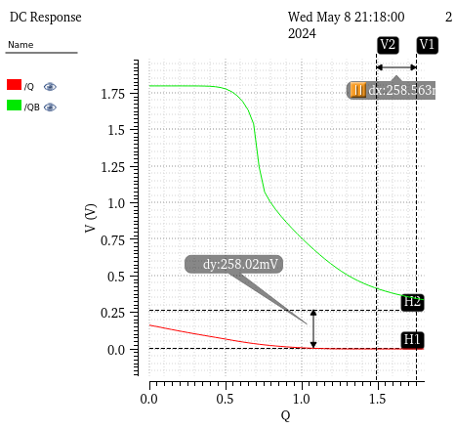
Static Random Access Memory (SRAM)
Fig: Butterfly curve of 6T SRAM cell during Write operation
Fig: Butterfly curve of 6T SRAM cell during Read operation
read-SNM value is 207.5mV
Fig: Butterfly curve of 6T SRAM cell during Hold operation
Hold-SNM value is 640mV
write-SNM value is 258.5mV

Slide 34
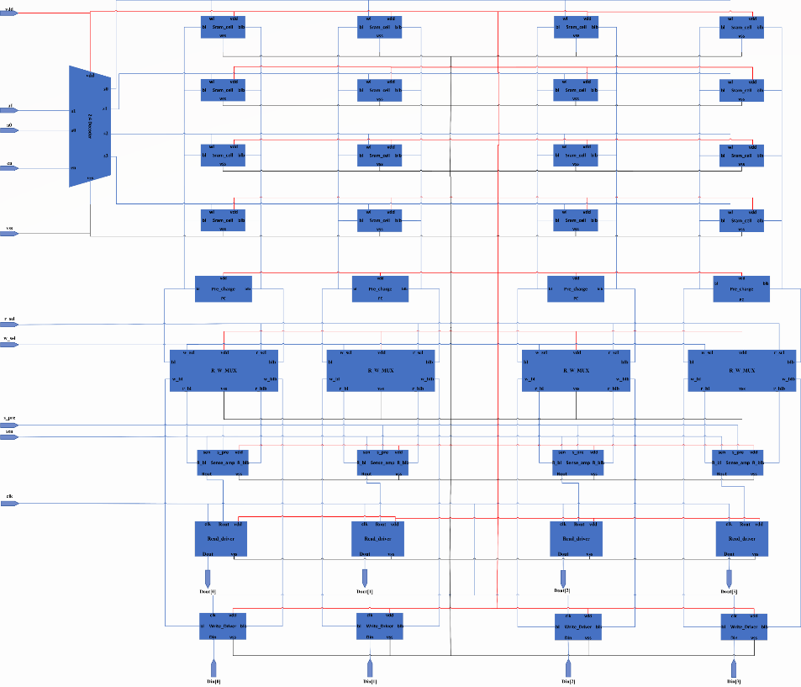
4x4 Sram Array schematic

Slide 35

4x4 Sram Array symbol

Slide 36
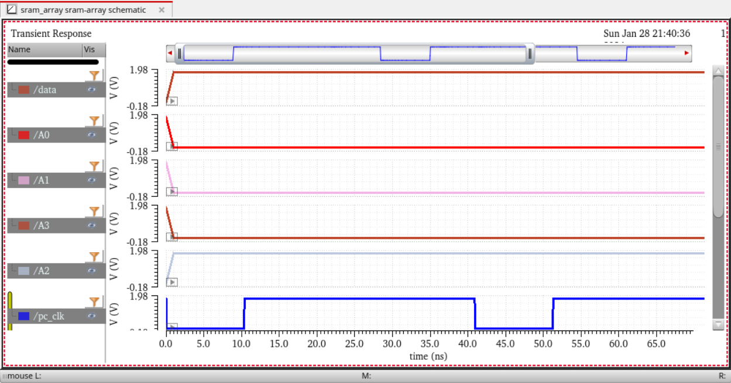
4x4 Sram array operation
First write-1 then read-1 in 4x4 sram array

Slide 37
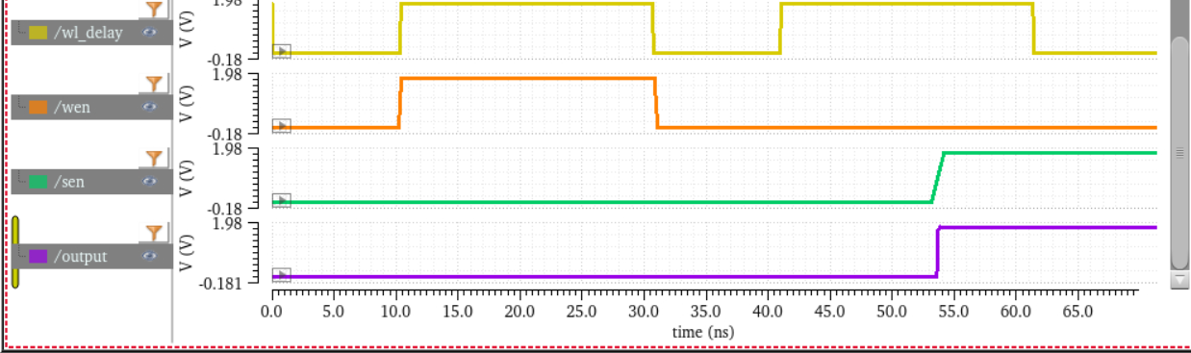

Slide 38
Thank you

